Slide 1

IBM HR Analytics Employee Attrition & Performance
Uche Obianyimuo, jack Ozcelik & Sarai EMbaye

Slide 2
Purpose of the Project
Purpose:
Analyze correlations within the dataset to determine attrition trends.
Scope:
Data source:
https://www.kaggle.com/pavansubhasht/ibm-hr-analytics-attrition-dataset
Resources:
https://matplotlib.org/3.2.0/gallery/lines_bars_and_markers/barchart.html#sphx-glr-gallery-lines-bars-and-markers-barchart-py
Jupyter notebook
Github
Pandas

Slide 3
Analytical Questions for the Data Set
What percentage of the sample population has experienced attrition within the company?
Is there a significant difference when it comes to male or female in the job performance?
If so, what major trends in other areas such as compensation do we see any trends. Are there any outliers?
What is the correlation between performance rating and department type and education?
How long have these employees typically held a position?
How many employees report that job satisfaction is high but work/life balance is low?
Does types of assertions can we make regarding the data?
There are discussions regarding that companies do not provide the same benefits in terms of retirement pension and health benefits. More employees seem to be switching jobs at an alarming rate. What is the average age distribution verses average time at the company?
Does the data show any relationship between ‘Educational Level’ versus ‘Employee Retention’?
Any relationship between ‘Attrition’ and ‘Department’? ‘Attrition’ versus ‘Education Field’? Etc.

Slide 4
Data visualization & Analysis

Slide 5
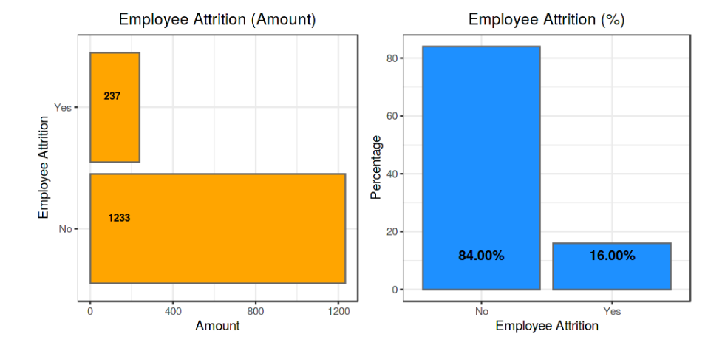


Slide 6
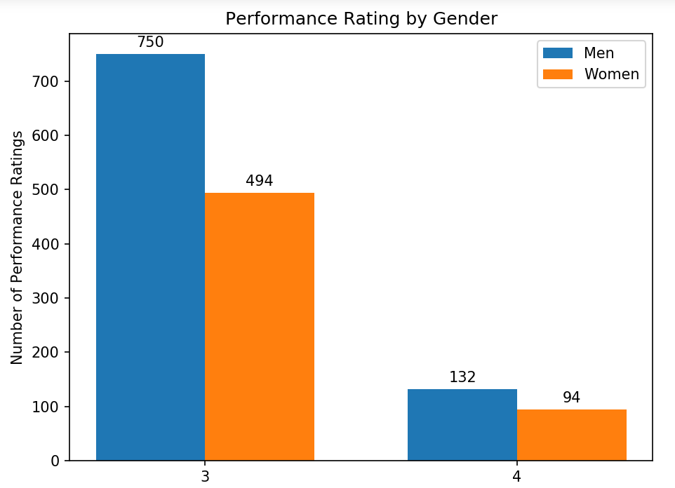
Is there a difference in gender that would cause us to see an attribution between male and female

Slide 7
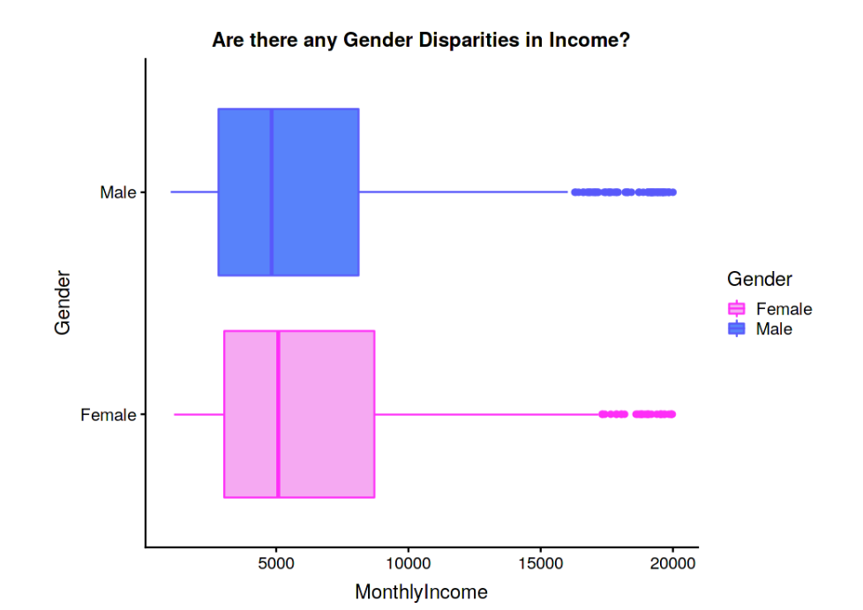

Slide 8
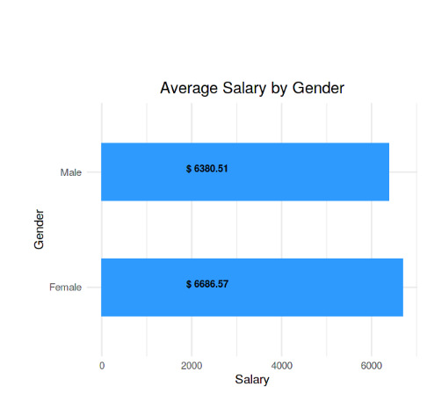


Slide 9
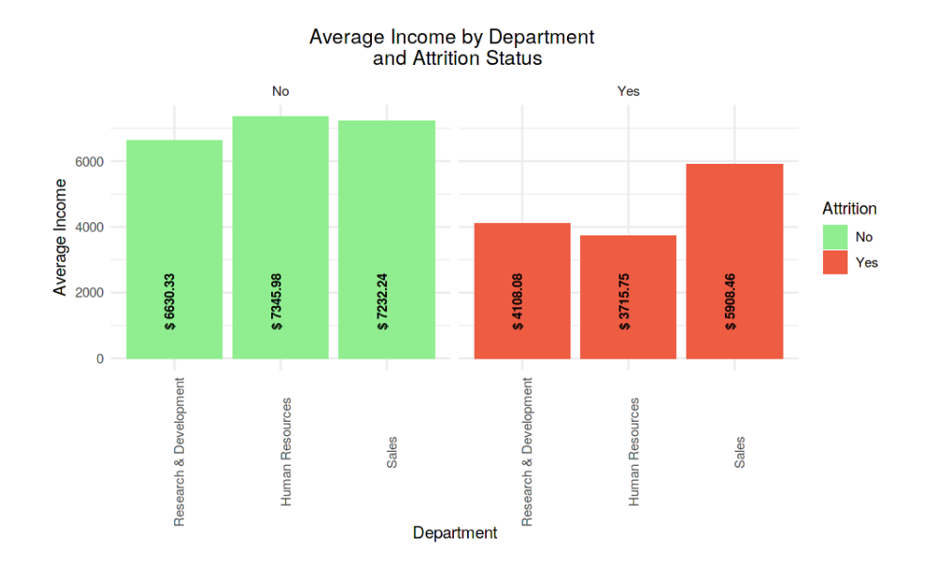
What is the Average Monthly Income per Employee within Each Department

Slide 10
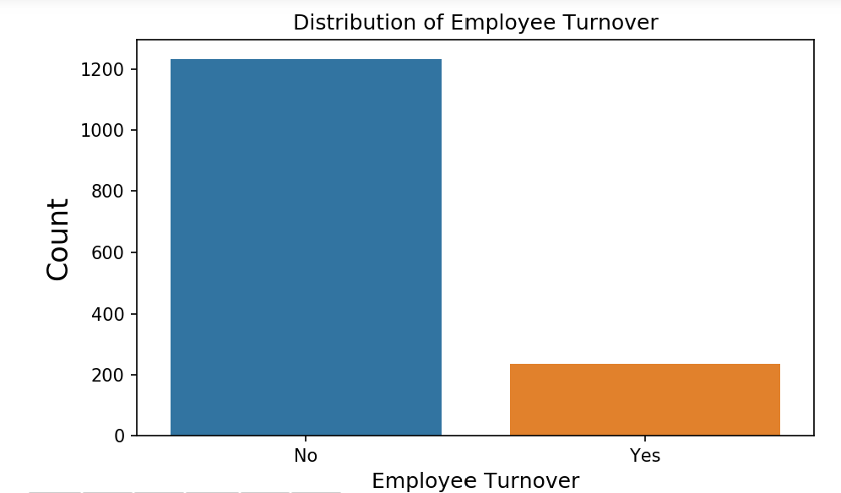

Slide 11
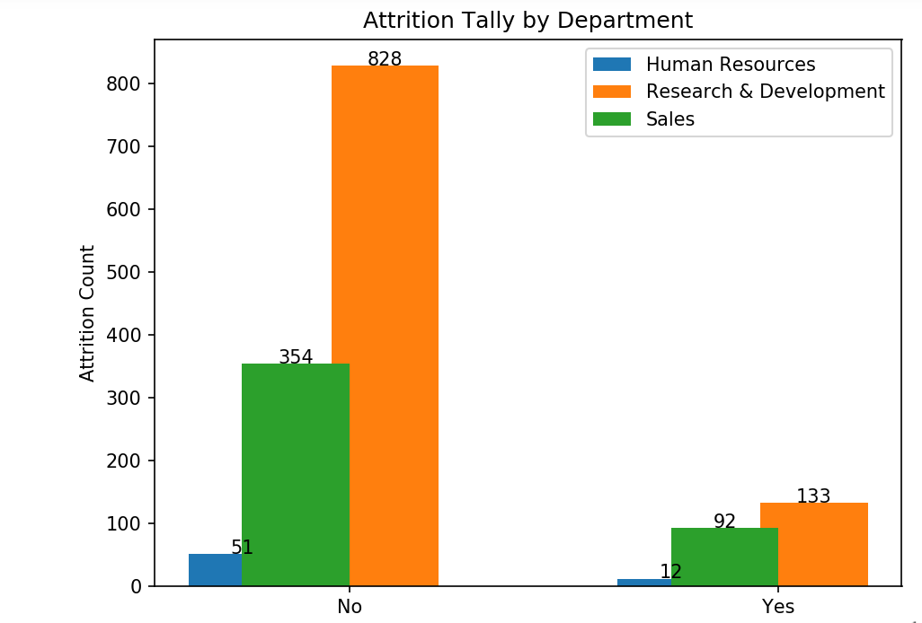
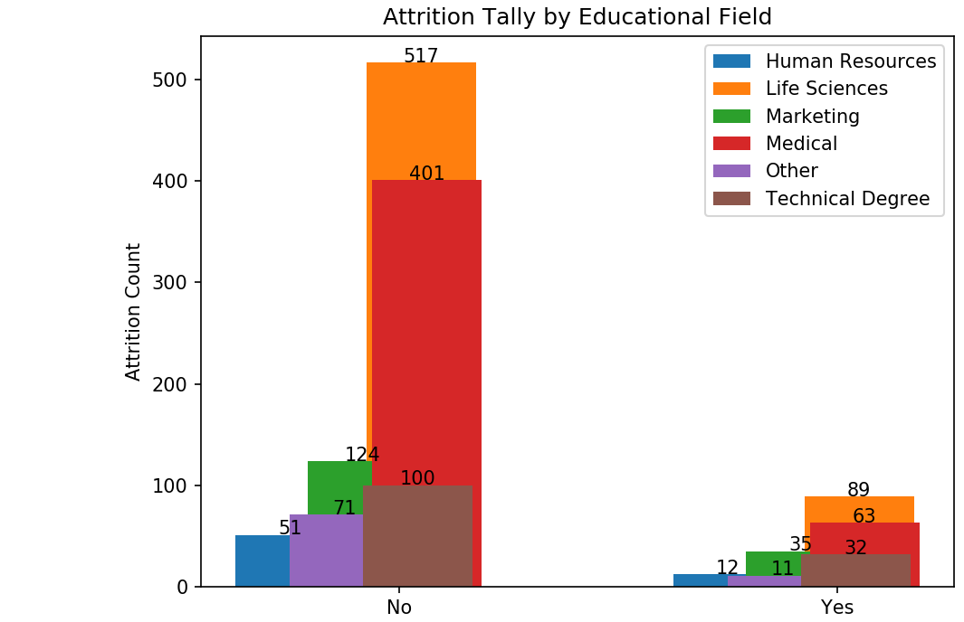

Slide 12
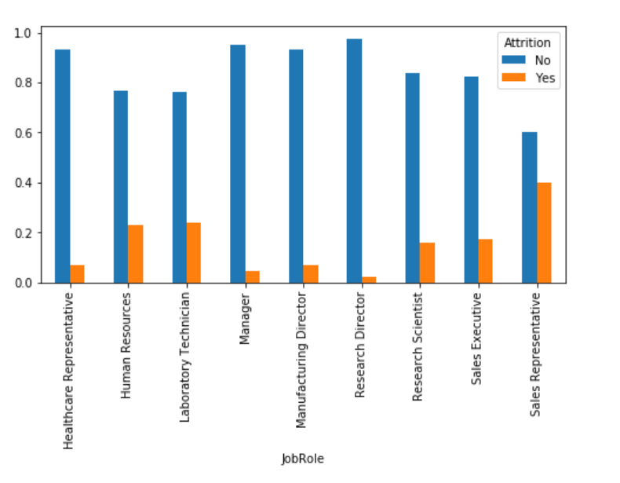
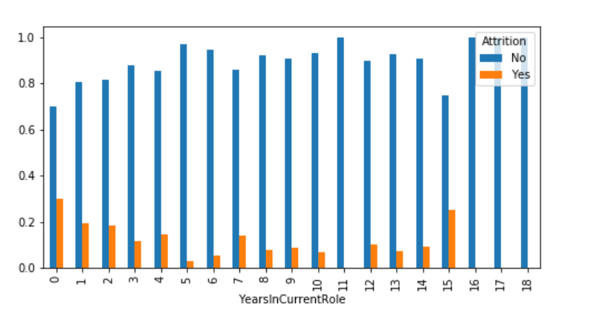

Slide 13
Conclusions and Questions
In Conclusion, we see that only a small percentage of individuals have left the company with the largest group being from life sciences.
Questions or Comments?

